Slide 1

Data Structures & Algorithms Insertion Sort
By
Ravi Kant Sahu
Asst. Professor
Lovely Professional University, Punjab

Slide 2
Insertion Sort

Slide 3
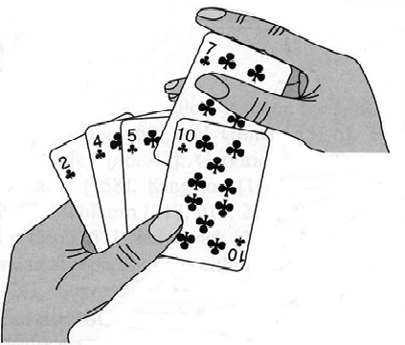
Insertion Sort

Slide 4
Insertion Sort
INSERTION_SORT (A, N)
Repeat Step 2 to 4 FOR J = 2 to N
Set Key = A[J] and I = J – 1.
Repeat Steps 4 and 5 WHILE I > 0 & Key < A[I]
Set A[I+1] = A[I]
Set I = I – 1. [End of step 3 Loop.]
Set A[I+1] = Key.
[End of Step 1 loop]
7. Return

Slide 5
Work Space

Slide 6
Insertion Sort Complexity
This Sorting algorithm is frequently used when n is very small.
Worst case occurs when array is in reverse order. The inner loop must use K – 1 comparisons.
f(n) = 1 + 2 + 3 + ….+ (n – 1) = n(n – 1)/2 = O(n²)
In average case, there will be approximately (K – 1)/2 comparisons in the inner loop.
f(n) = 1 + 2 + 3 + ….+ (n – 1)/2 = n(n – 1)/4 = O(n²)

Slide 7
Exercise
Apply Insertion Sort to sort the following array in descending order:
7, 3, 9, 4, 6, 2, 4

Slide 8


